Slide 1
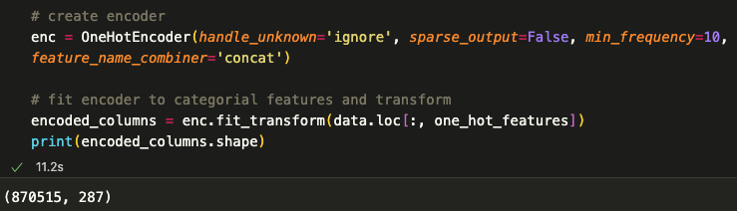
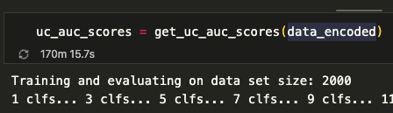
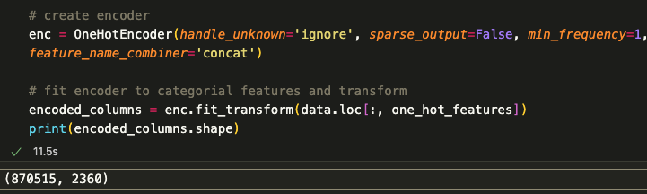
One important difference in our scripts is the one hot encoding. I had originally set min_frequency=10 so it would run quickly. Setting it equal to 1 (i.e. one hot encoding all possible values) makes run time exponentially longer
Could not find a runtime in Dr. Mohsen’s paper

Slide 2
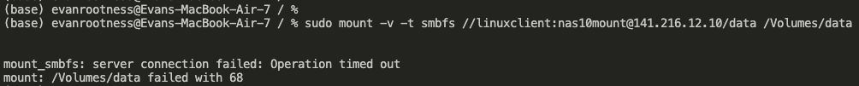
Unable to connect to workstation

Slide 3
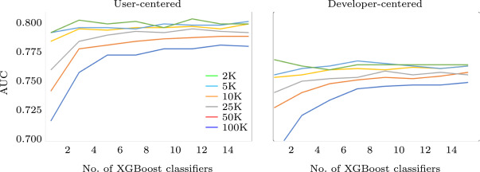
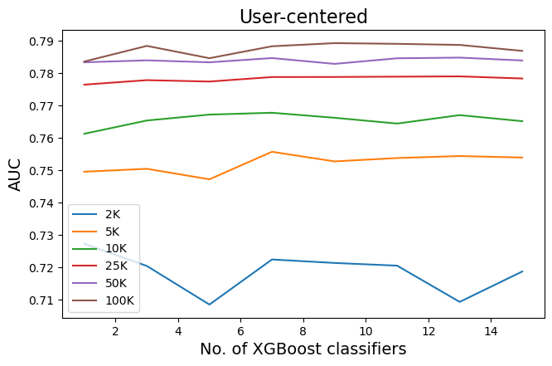
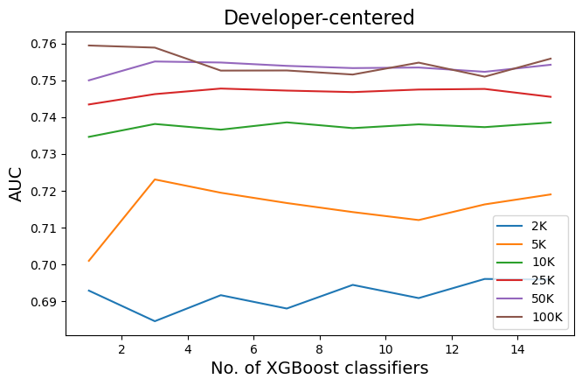
Dr Mohsen’s results
My results

